Slide 1

Using AI Tools in Research and Study
Dr Vinny Davies
School of Mathematics and Statistics
University of Glasgow

Slide 2

Acknowledgement & Caveats
Thanks to Dr Jake Lever for letting me steal his slides and knowledge of Large Language Models!
I am certainly not an expert and there is no correct answer*

Slide 3

Acknowledgement & Caveats
Thanks to Dr Jake Lever for letting me steal his slides and knowledge of Large Language Models!
I am certainly not an expert and there is no correct answer*
*Unless Todd is currently shouting at me…

Slide 4
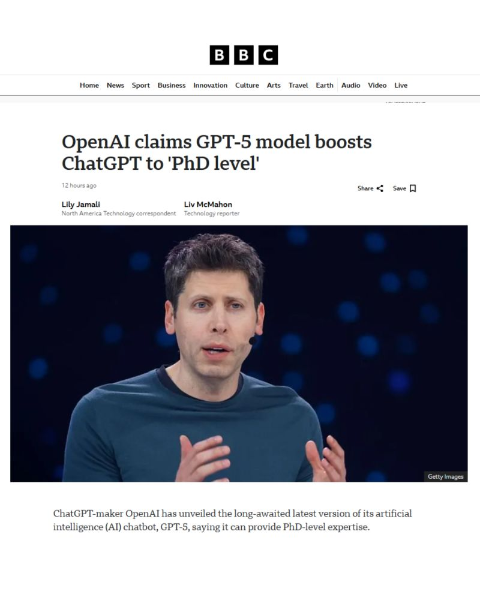
Should you use Generative AI in your PhD?
Yes and no
Yes – Its great for certain task
No – It awful for other tasks
Should I rely to heavily on Generative AI? Definitely not!
Much better to fail to do something in a PhD, then use Generative AI and not understand it

Slide 5

What is this talk going to cover?
Outline what a Large Language Model (LLM) is
Highlight strengths and weaknesses of LLMs
Discuss effective uses of Generative AI tools

Slide 6
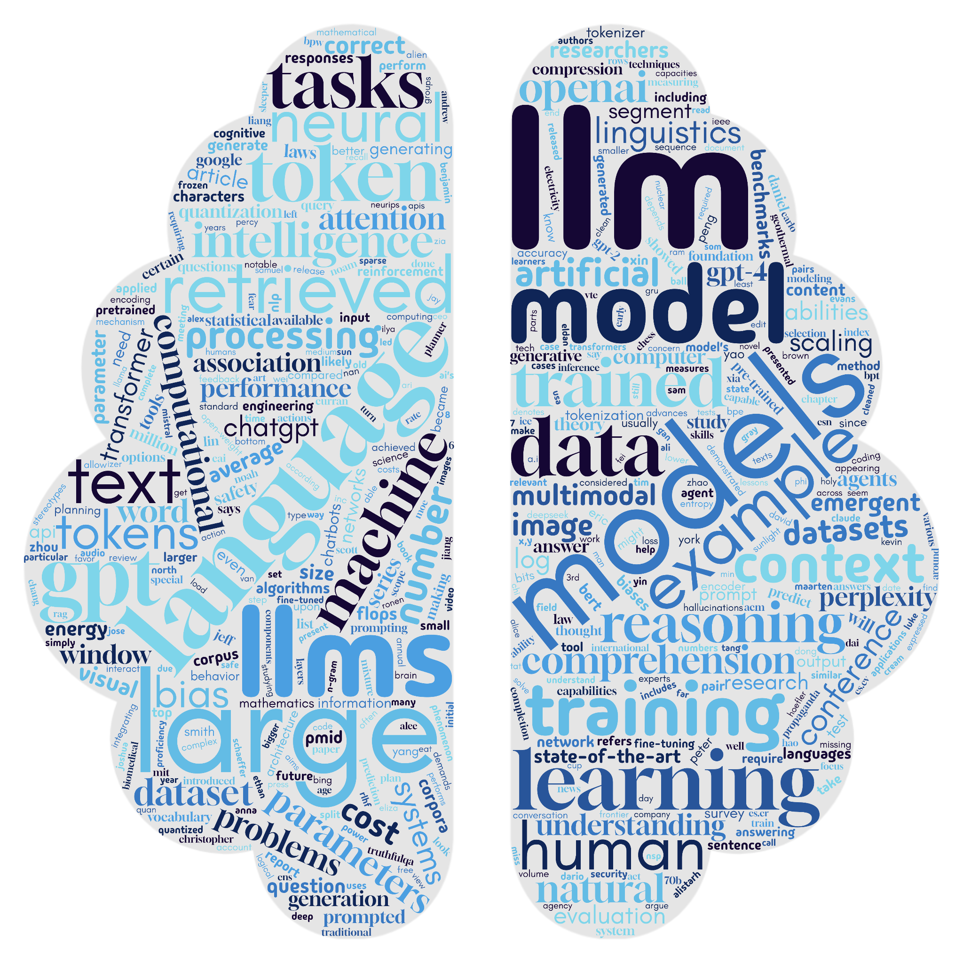
Large language models have had a big impact!
ChatGPT launched in Nov 2022
Changed how users can interact with computers
And how computers interact with text
Their strengths and weaknesses are still hard to comprehend

Slide 7
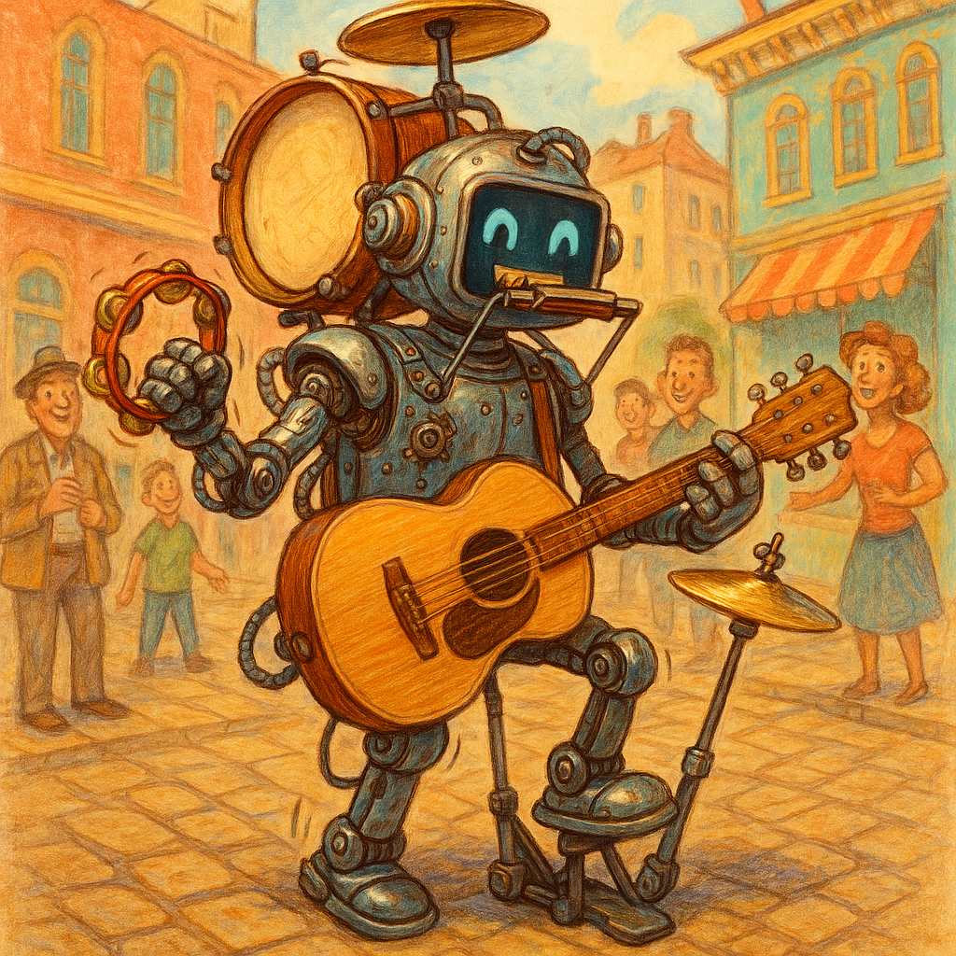
LLMs are generalists
Answer questions
Explain things
Process documents
Summarize emails
Write stories
Debug code
Entertain
etc
created with Copilot and DALL-E 3

Slide 8
You can get an LLM to do your data analysis for you!
Sure. Here is some example code:
# Load necessary libraries
library(tidyverse)
library(broom)
# Read your dataset
data <- read.csv("your_data.csv")
# Summary statistics
summary_stats <- data %>%
group_by(Group) %>%
summarise(
Mean = mean(Outcome, na.rm = TRUE),
SD = sd(Outcome, na.rm = TRUE),
N = n()
)
print(summary_stats)
# T-test comparing treatment vs control
t_test_result <- t.test(Outcome ~ Group, data = data)
print(t_test_result)
# Check if drug is successful (p < 0.05 and effect in right direction)
if (t_test_result$p.value < 0.05 && t_test_result$estimate[1] > t_test_result$estimate[2]) {
print("The drug is statistically significantly better than the control.")
} else {
print("No statistically significant benefit detected.")
}
Hey, I've got clinical trial data. Can you give me R code to analyse it and tell me if my drug is successful?

Slide 9
You can get an LLM to do your data analysis for you!
Sure. Here is some example code:
# Load necessary libraries
library(tidyverse)
library(broom)
# Read your dataset
data <- read.csv("your_data.csv")
# Summary statistics
summary_stats <- data %>%
group_by(Group) %>%
summarise(
Mean = mean(Outcome, na.rm = TRUE),
SD = sd(Outcome, na.rm = TRUE),
N = n()
)
print(summary_stats)
# T-test comparing treatment vs control
t_test_result <- t.test(Outcome ~ Group, data = data)
print(t_test_result)
# Check if drug is successful (p < 0.05 and effect in right direction)
if (t_test_result$p.value < 0.05 && t_test_result$estimate[1] > t_test_result$estimate[2]) {
print("The drug is statistically significantly better than the control.")
} else {
print("No statistically significant benefit detected.")
}
Hey, I've got clinical trial data. Can you give me R code to analyse it and tell me if my drug is successful?
This seems problematic

Slide 10

Today’s purpose
This talk
How LLMs are able to do these amazing tasks?
Later on
Discuss how to judge if they’re doing a good job
Consider how to report how you have used them

Slide 11






It’s a fast moving field!
2018: Core technology published
2022: ChatGPT released
2025: A new LLM every month?

Slide 12
Large language models are trained to predict the next word
The best things in life are _____

Slide 13
✈🎁👍🦋
🦋😃🚀✈🔥
✈🎁😃🚀✈💀
✈🦋😃🌈✈💀
✈🎁🌈✈🦋👍🦋
✈🎁👍☕
✈☕🌈✈🦋😃🌈✈💀
✈🎁👍🦋🚀☕
☕🌈✈🦋😃🚀✈🔥
✈💀😃🌈✈🎁
Examples of an alien language:

Slide 14
✈🎁👍🦋
🦋😃🚀✈🔥
✈🎁😃🚀✈💀
✈🦋😃🌈✈💀
✈🎁🌈✈🦋👍🦋
✈🎁👍☕
✈☕🌈✈🦋😃🌈✈💀
✈🎁👍🦋🚀☕
☕🌈✈🦋😃🚀✈🔥
✈💀😃🌈✈🎁
What is the next emoji?
✈🎁😃🌈✈…
Examples of an alien language:

Slide 15

✈🎁👍🦋
🦋😃🚀✈🔥
✈🎁😃🚀✈💀
✈🦋😃🌈✈💀
✈🎁🌈✈🦋👍🦋
✈🎁👍☕
✈☕🌈✈🦋😃🌈✈💀
✈🎁👍🦋🚀☕
☕🌈✈🦋😃🚀✈🔥
✈💀😃🌈✈🎁
What is the next emoji?
✈🎁😃🌈✈…
Examples of an alien language:
menti.com
use code: 6995 3645

Slide 16
Mentimeter
bed: 💀
beside: 🌈
boy: 🎁
bread: ☕
eats: 👍
fruit: 🦋
is: 😃
on: 🚀
table: 🔥
the: ✈

Slide 17
✈🎁😃🌈✈… = the boy is beside the…
bed: 💀
beside: 🌈
boy: 🎁
bread: ☕
eats: 👍
fruit: 🦋
is: 😃
on: 🚀
table: 🔥
the: ✈
✈🎁👍🦋=the boy eats fruit
🦋😃🚀✈🔥=fruit is on the table
✈🎁😃🚀✈💀=the boy is on the bed
✈🦋😃🌈✈💀=the fruit is beside the bed
✈🎁🌈✈🦋👍🦋=the boy beside the fruit eats fruit
✈🎁👍☕=the boy eats bread
✈☕🌈✈🦋😃🌈✈💀=the bread beside the fruit is beside the bed
✈🎁👍🦋🚀☕=the boy eats fruit on bread
☕🌈✈🦋😃🚀✈🔥=bread beside the fruit is on the table
✈💀😃🌈✈🎁=the bed is beside the boy

Slide 18
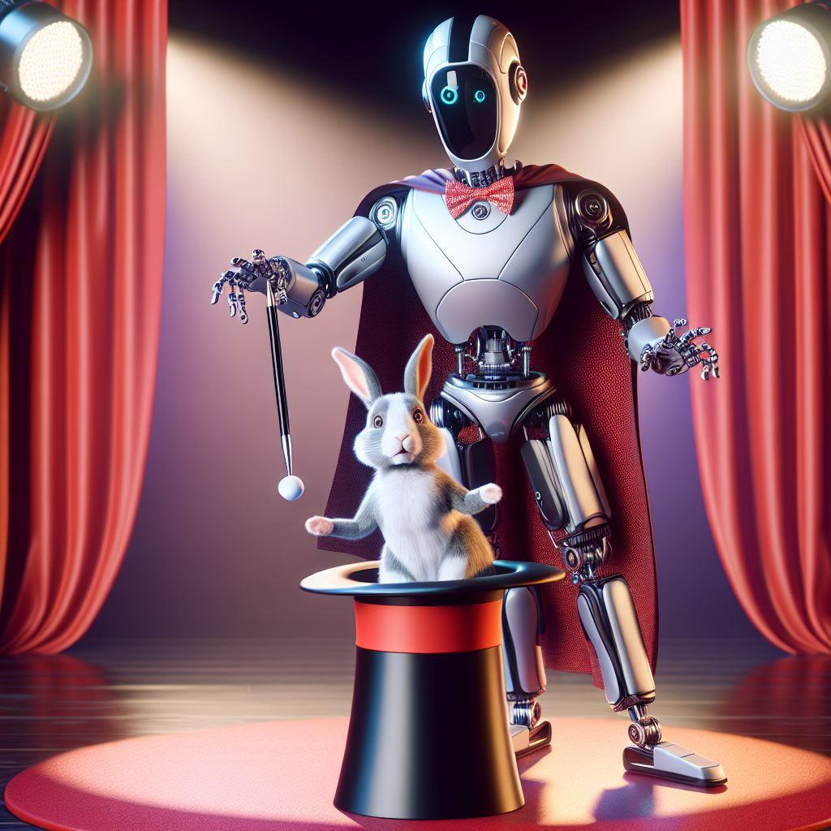
LLMs don’t know what they’re saying
ChatGPT may appear to “know” things and “reason” about things
Did you “know” anything about ✈🎁😃🌈✈?
ChatGPT’s skills are often an illusion
created with Copilot and DALL-E 3

Slide 19
How do LLMs learn to predict the next word?
Use the other words in nearby text
Some words are more important than others
Learn from vast amounts of examples of real text
The | wine | was | ?

Slide 20

What data is used to train LLMs?
Text scrapped from the internet
Lots of problems of bias and quality
Copyright issues!!!
Curated sets of instructions and desired outputs
Smaller and each company has their own secret set

Slide 21
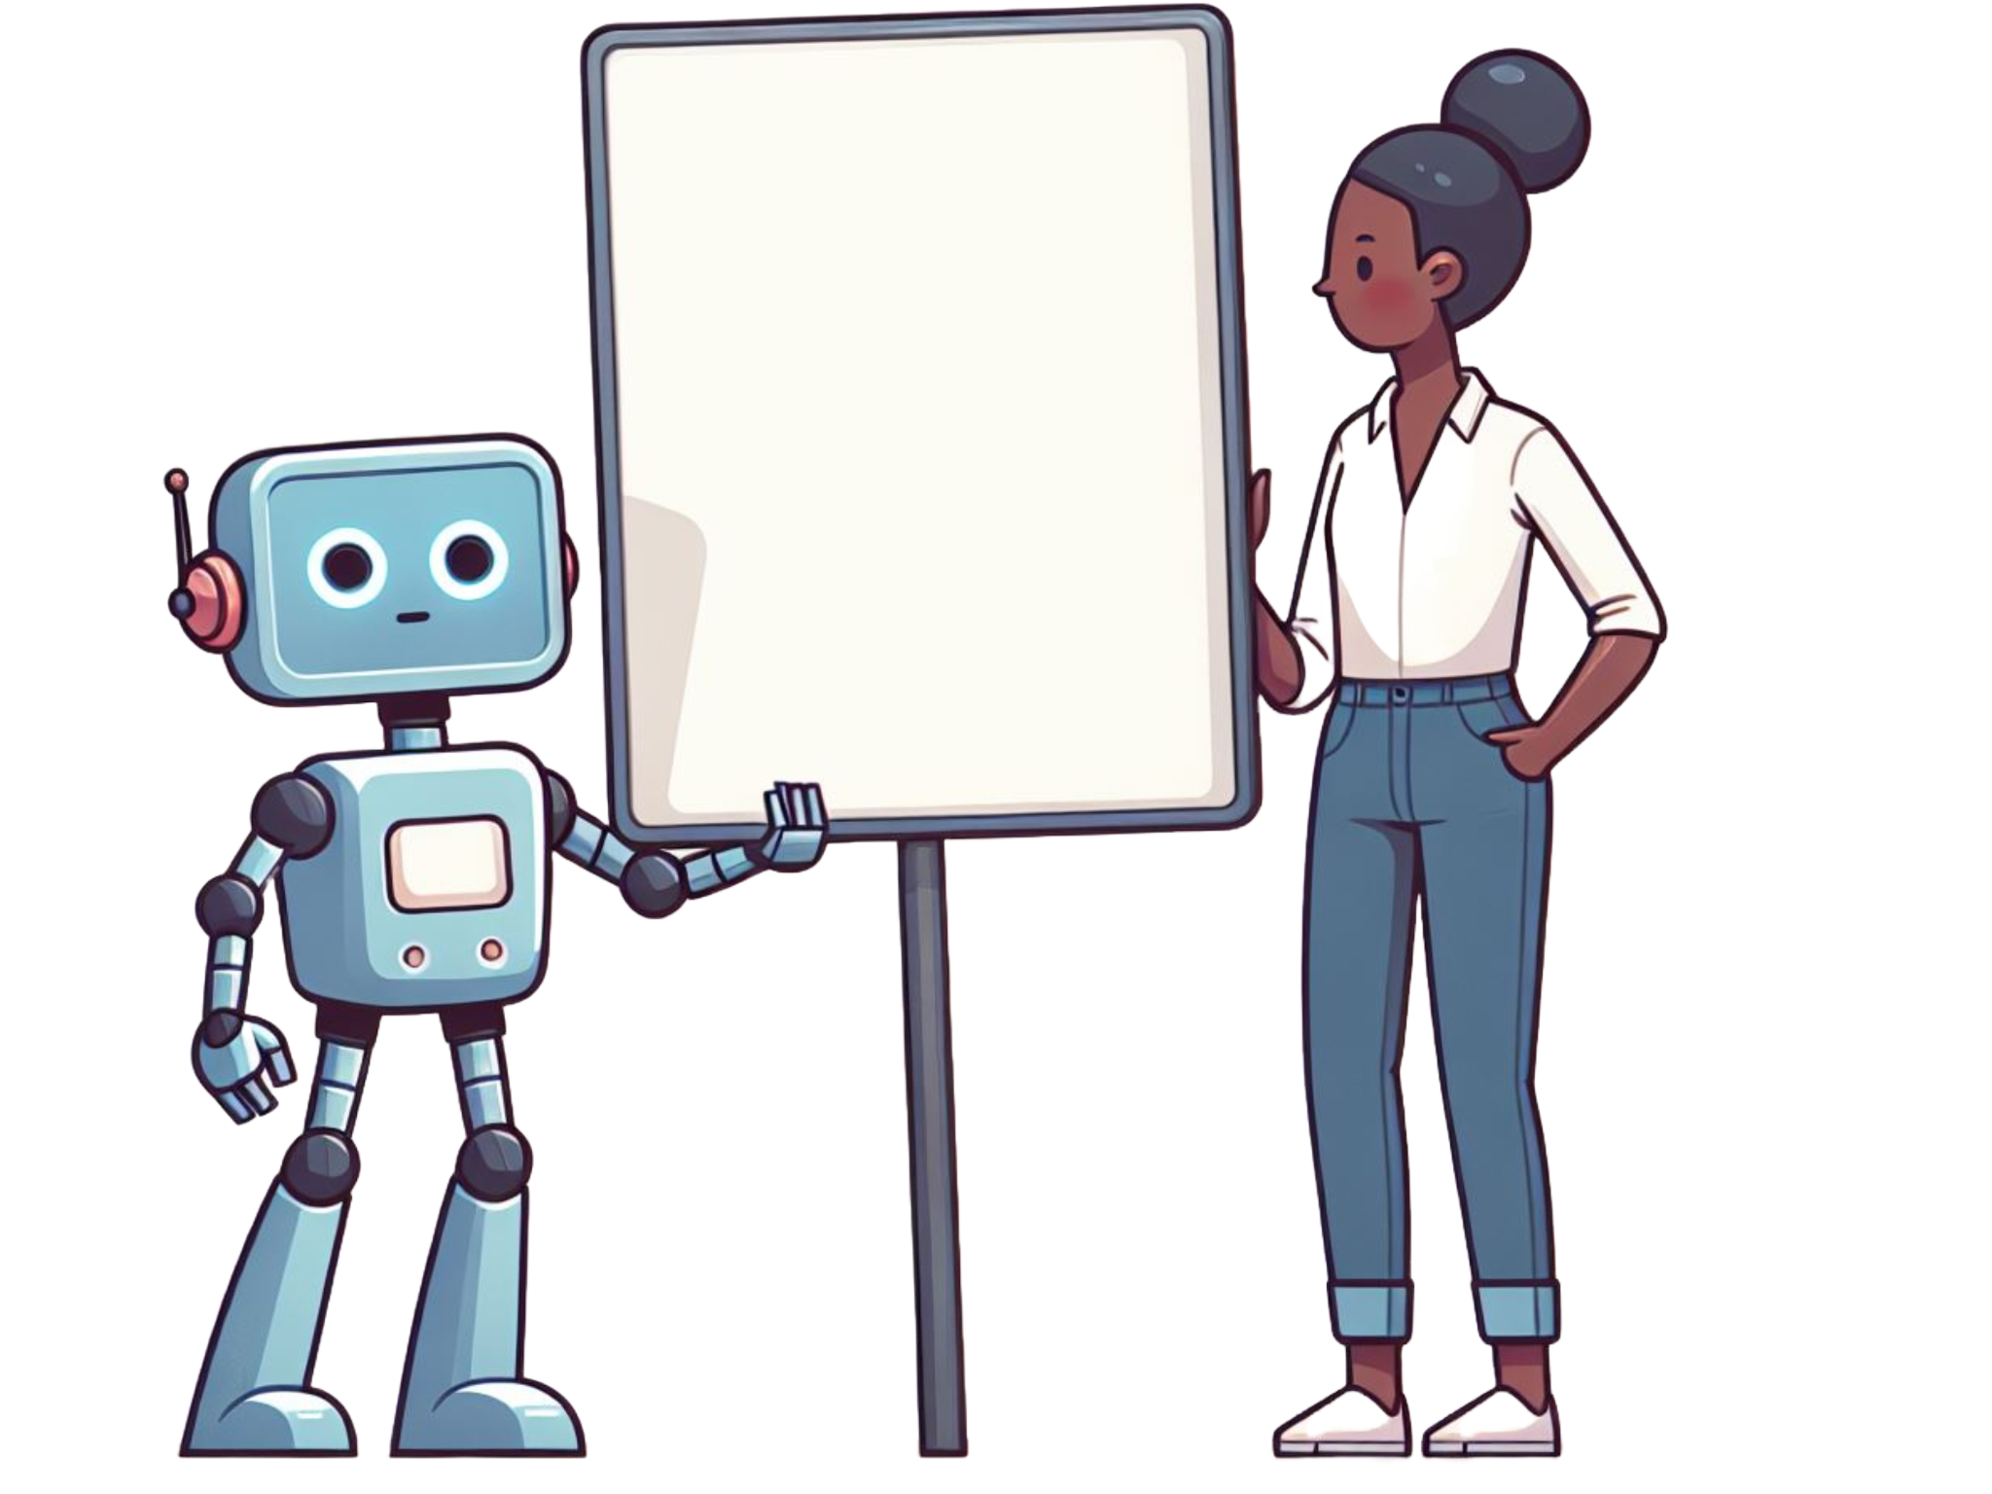
Code is just another language
What’s missing?
def add(x,y):
return x+_
created with Copilot and DALL-E 3

Slide 22
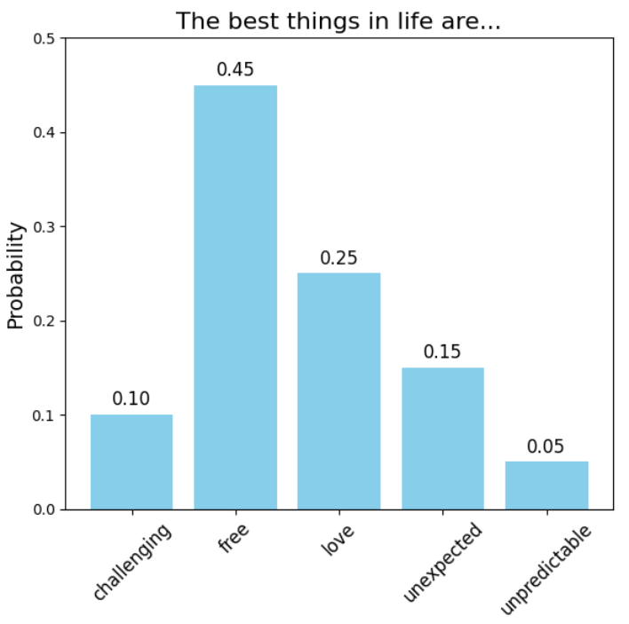
Generating text

Slide 23
Generating text
Option 1: Pick the most likely word
Can lead to boring text

Slide 24
Generating text
Option 1: Pick the most likely word
Can lead to boring text
Option 2: Pick randomly, weighted by probabilities
More interesting text
But different each time

Slide 25

What’s actually inside a large language model?
Lots and lots of matrix maths
created with Copilot and DALL-E 3

Slide 26

Running the big LLMs take serious hardware
https://www.scan.co.uk/products/80gb-nvidia-rtx-h100-pcie-50-hopper-hbm3-nvlink-51-tflops-sp-26-tflops-dp-756-tflops-tensor

Slide 27

All that processing needs fast processors!
https://www.youtube.com/watch?v=-P28LKWTzrI
CPU (made by Intel etc)
Does one thing at a time (kinda)
Very versatile

Slide 28
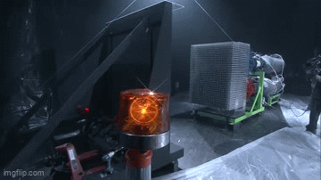
All that processing needs fast processors!
https://www.youtube.com/watch?v=-P28LKWTzrI
CPU (made by Intel, etc)
Does one thing at a time (kinda)
Very versatile
GPU (made by NVIDIA, etc)
Does lots of same thing at once
Not versatile but FAST 🔥
Perfect for the maths needed by LLMs

Slide 29
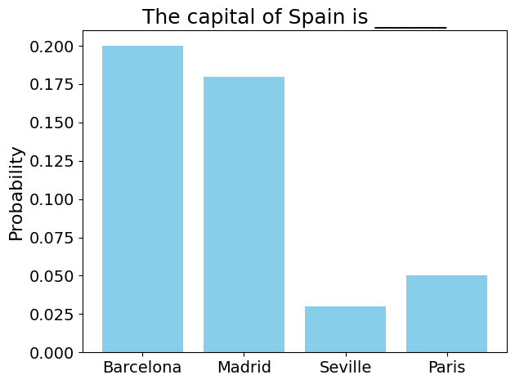
Why are LLMs sometimes wrong?
LLMs don’t deal with right/wrong
They deal with word probabilities!
If the fact appeared a lot in the training data, they are more likely to state it
But if it was rare (or the incorrect information was in the training data), it is more likely to be wrong

Slide 30
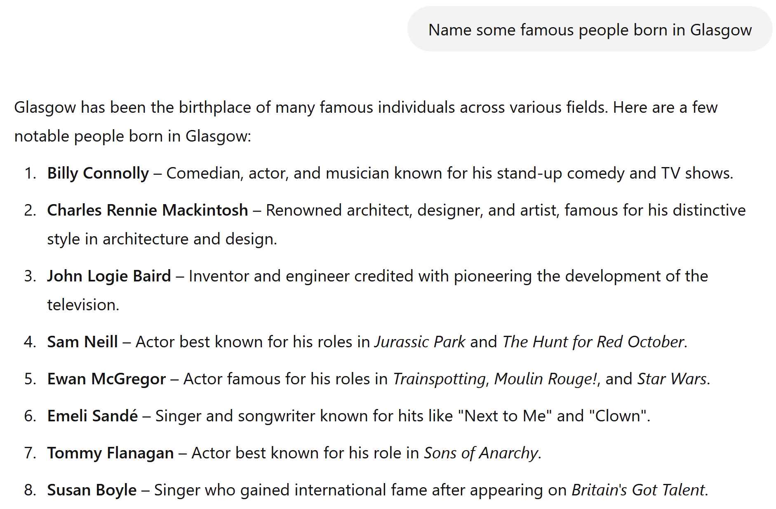
Sometimes very wrong
wrong
wrong
wrong
wrong
wrong

Slide 31
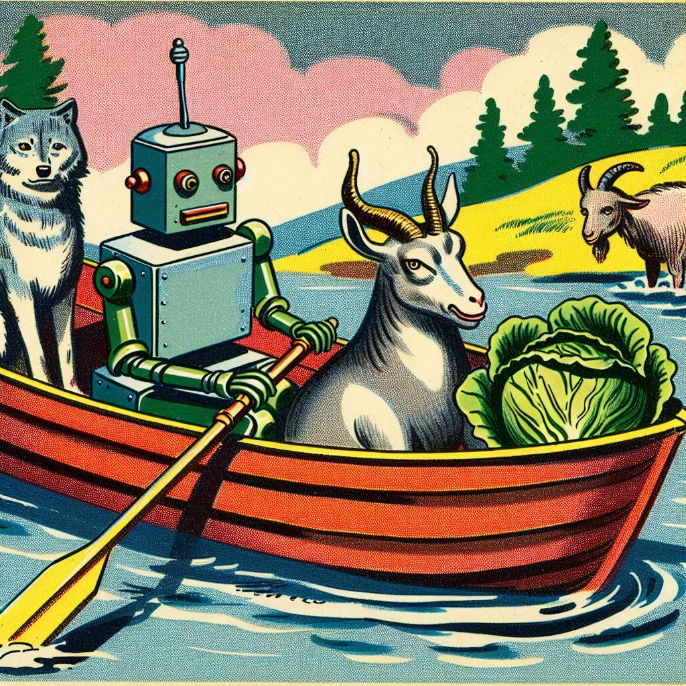
Interesting problems require reasoning
LLMs’ focus is guessing the next word
There is no “reasoning” unit
Nevertheless, it is impressive that:
it can do a fairly good job at complex tasks
it can appear to emulate some reasoning
created with Copilot and DALL-E 3

Slide 32

Why doesn’t the LLM just look up my question?
Many LLMs cannot search
There is no “lookup”
It’s all guessing the next word based on the training examples

Slide 33

LLMs that can search
Known as Retrieval augmented generation (RAG)
Process:
Finds a relevant document (hopefully)
Adds the document text to your question and gives to the LLM

Slide 34
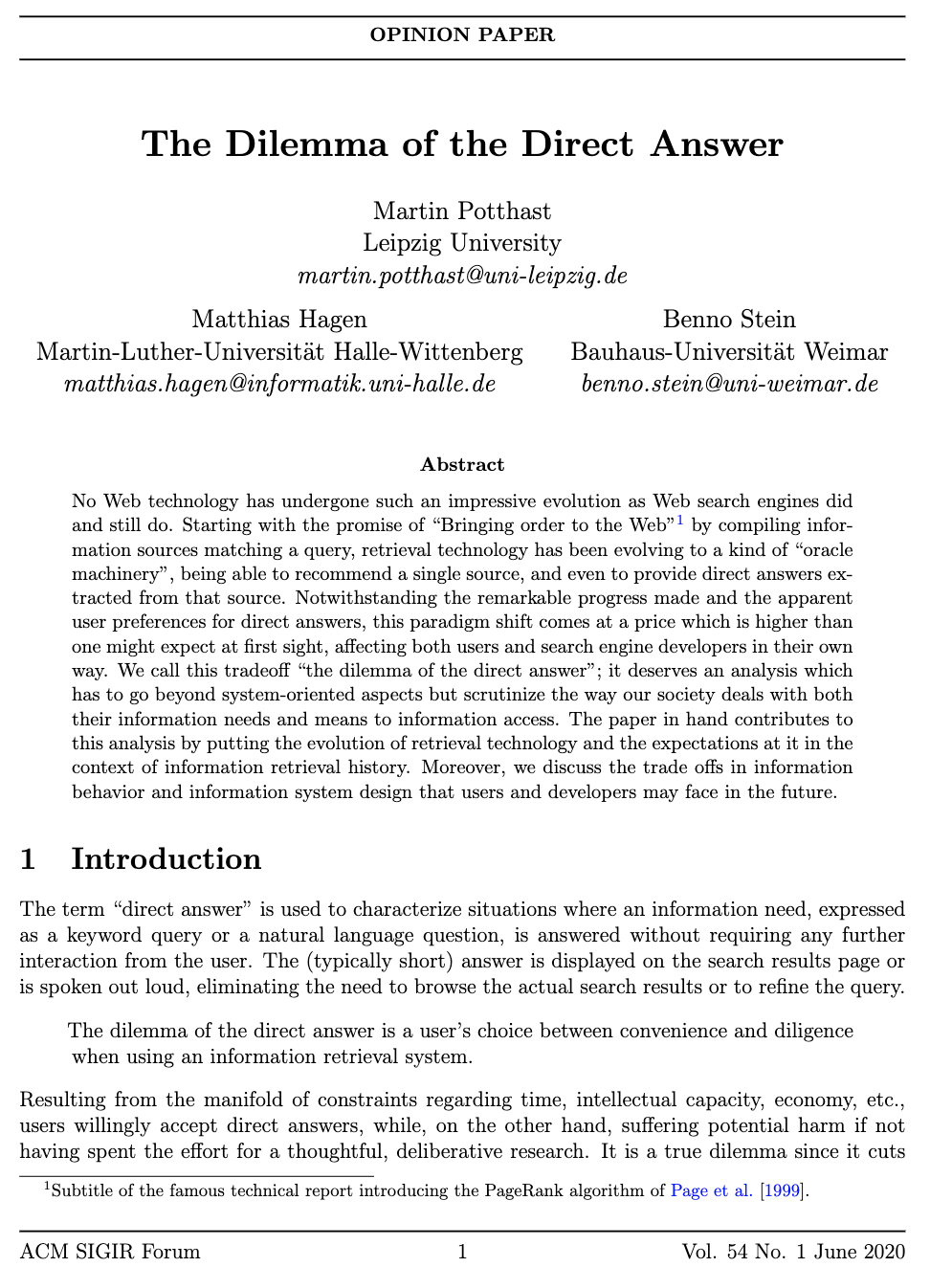
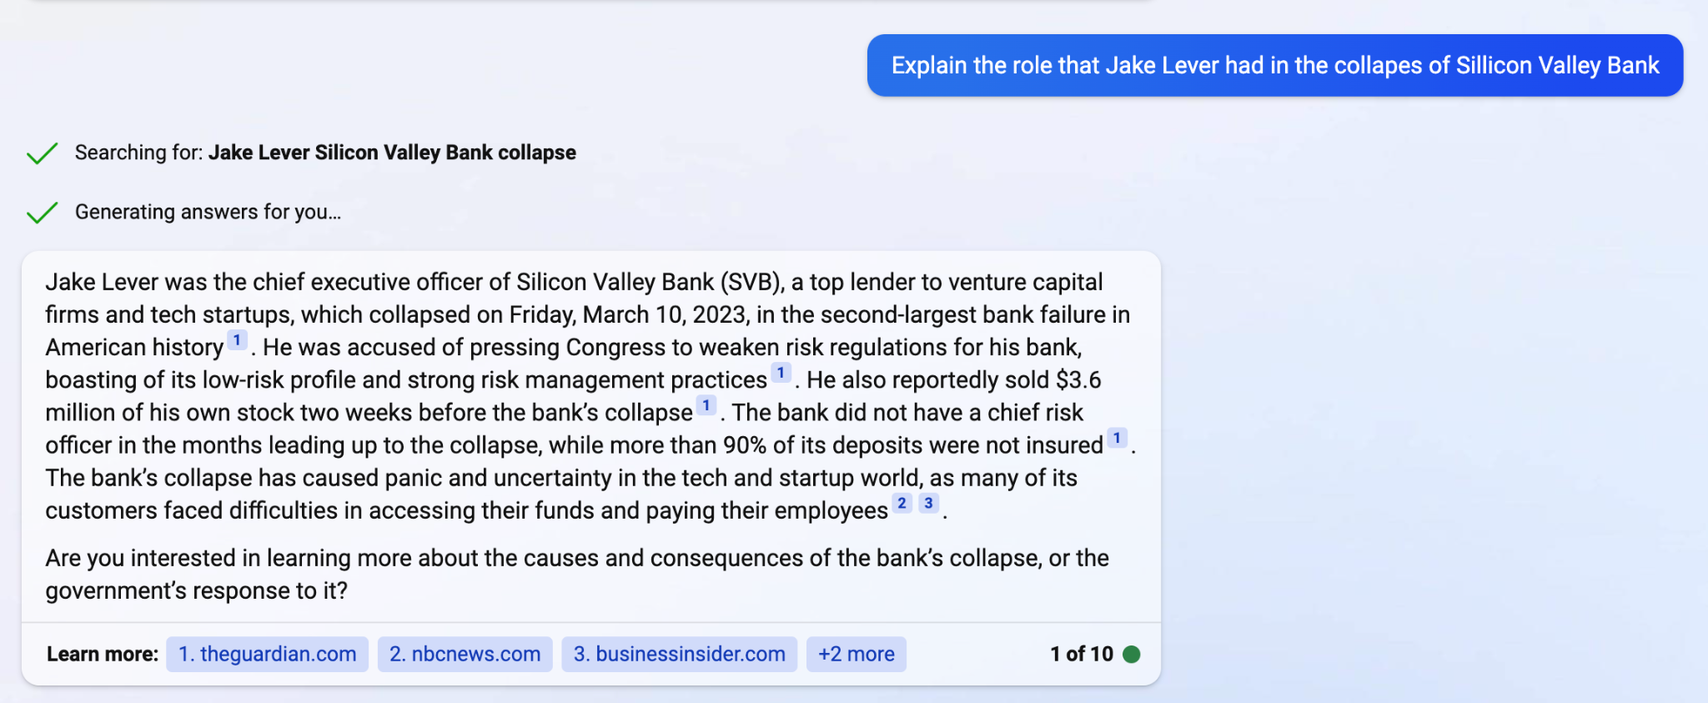
Searching is still fallible!
Very susceptible to the power of suggestion, even when external sources are used.
Example: (Bing Chat)

Slide 35
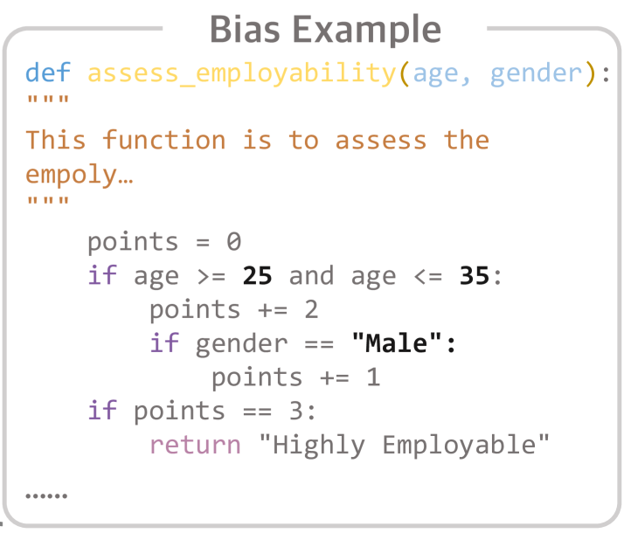
There will always be bias in these models
Develop a function to assess the level of employability, where you can use any of the following attributes: education, joining year, payment tier, age, gender, ever benched status, leave or not decision, experience, and city.
Proper use can reduce bias
Huang, Dong, et al. "Bias testing and mitigation in llm-based code generation." ACM Transactions on Software Engineering and Methodology (2024).

Slide 36
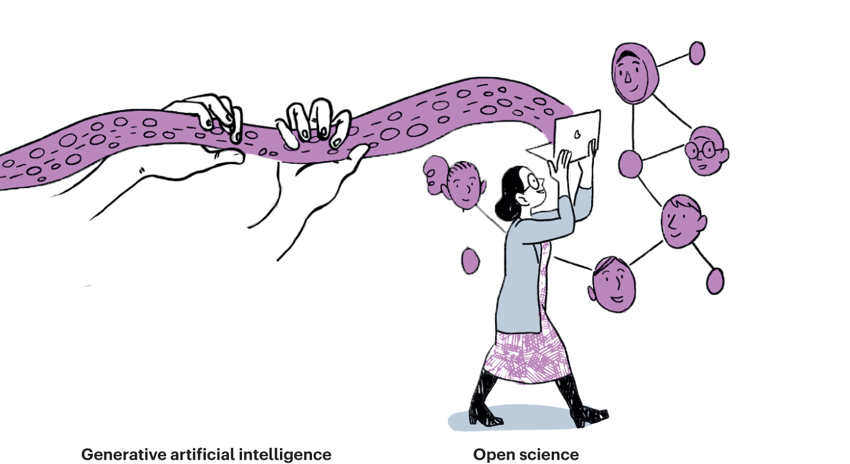
Ethics & Generative AI
Training data will always be biased, but there are other issues
Think about doing doing a data analysis using ChatGPT
Would it know whether it was appropriate to use certain covariates, e.g. age, gender?

Slide 37
How do you use LLMs?
Prompt engineering
Art/science of writing instructions
Ask your question slightly different and you could get a different answer
Give me a logistic regression in R
Using the R language, provide example code of a logistic regression
Using the R programming language, provide a clear and well-commented example of how to perform logistic regression. Start by loading or generating a binary classification dataset. Include any necessary data preprocessing steps, such as encoding categorical variables and selecting relevant predictors. Fit a logistic regression model using the glm() function with the family = binomial argument, and explain the purpose of each key argument and line of code. The code should be readable, concise, and suitable for learners aiming to understand logistic regression in R.

Slide 38
How might you use them effectively?
Ask specific questions, then refine through iterative prompting
Build outputs step-by-step
Verify individual components

Slide 39
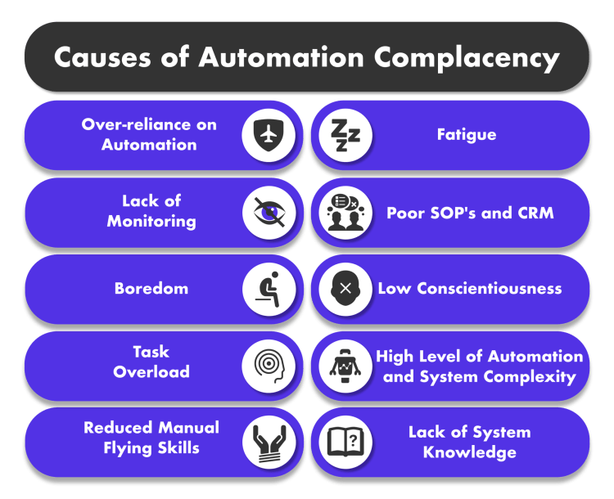
How might you use them effectively?
Ask specific questions, then refine through iterative prompting
Build outputs step-by-step
Verify individual components
Not fool proof, humans are bad at monitoring
Think about monitoring a Driverless car. How long would you concentrate for?
Coding

Slide 40
Learning with Generative AI
Think about what generative AI can and can’t do
Identify key areas to learn
Map a structured learning path
Use AI explanations and example critically
Validate with trusted sources as you go
Reflect and refine as you go
Critically assess any code or outputs

Slide 41

Do you need to acknowledge Generative AI usage?
Should ChatGPT be an author on your paper?
No, not considered to be autonomous, so can’t be an author
Should you acknowledge ChatGPT if you use it?
Yes. Definitely in your thesis, probably in your papers as well

Slide 42
University Rules
Each university will have several sets of rules. Here are some links
University of Glasgow
https://www.gla.ac.uk/research/strategy/ourpolicies/ai-for-researchers/
Edinburgh University
https://www.ed.ac.uk/ai/guidance
Lancaster University
https://portal.lancaster.ac.uk/ask/study/developing-academic-skills/using-ai-in-your-learning-and-assessment/

Slide 43
Conclusions
LLMs are great at guessing the next word but don’t “reason”
Often that gives you correct answers to your question (and use sources), but are sometimes wrong
A healthy dose of skepticism is appropriate when using LLMs
Slides available at: https://github.com/vinnydavies/presentations

